Slide 1
Media Service Provider
Submitted by:Bhavithra Bharath
Under the guidance of:Amruta Deore

Slide 2
Agenda
Objective
Logo
Introduction
Abstract
Uml Diagram
Main Feautures
Advantages
Software Requirements
Conclusion
Output

Slide 3
Objectives
The Main Objective of media service provider is to Stream Millions of song in one place for free

Slide 4
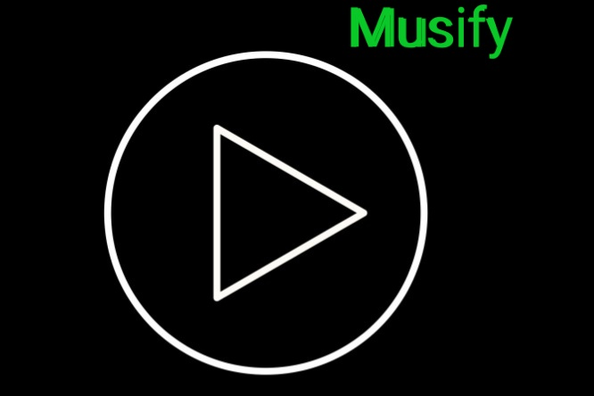
LOGO FOR MY PROJECT

Slide 5
Introduction
Media Service Provider is to allow the normal people to stream old music,recent music,to play all gener music.
Media service provider allows user to keep up to date his profile .It’ll also facilitate keeping all the records of users, such as their id, name, mailing address, phone number.So all the information about an user will be available and provide personalized experience

Slide 6
Abstract
Media service provider can be used by anyone which help us to listen to stream millions of music Achieving this objective is difficult using a manual system as it is not possible to download every songs and collecting every songs may be very time consuming.
All these problems are solved using this project.Media service provider is a software which is helpful for music lovers as well as the normal people to play our favourite songs,find new music,Listen to songs and albums for free.

Slide 7
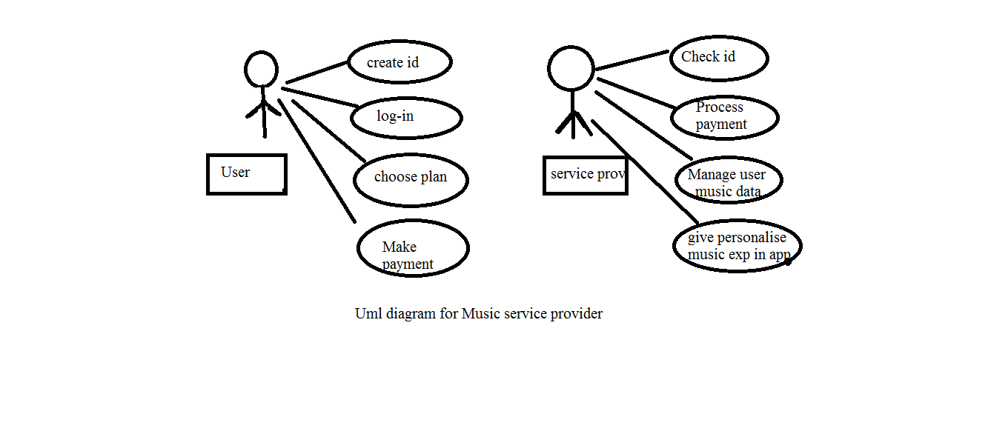
Uml Diagram

Slide 8
Main Feautres
In this Music provider we have an option called premium Account which is used to get some benifits such as ad free,offline mode etc rather than free account
For that premium Account we have to pay for months or an year
Its have different plans and easy payment option
In addition, It have free web player and we can access it from any device.

Slide 9
Advantages
Stream Millions of Music
Cost efficient
Easy payment method
User Friendly

Slide 10
Software Requirements
Operating System - Windows 10.
Platform - Notepad++.
Language - HTML,CSS,Javascript.
Files - stylesheet,html.

Slide 11
Conclusion
In today world music becames a part of human life.we listen to Music while cooking,eating,in lesiure time and even in working hours.
With help of this Music Service Provider any people can be able to stream millions of music easily. Achieving this objective is difficult using the manual system as the music is scattered, can be redundant, and collecting lot of music may be very time-consuming. All these problems are solved by this project.

Slide 12
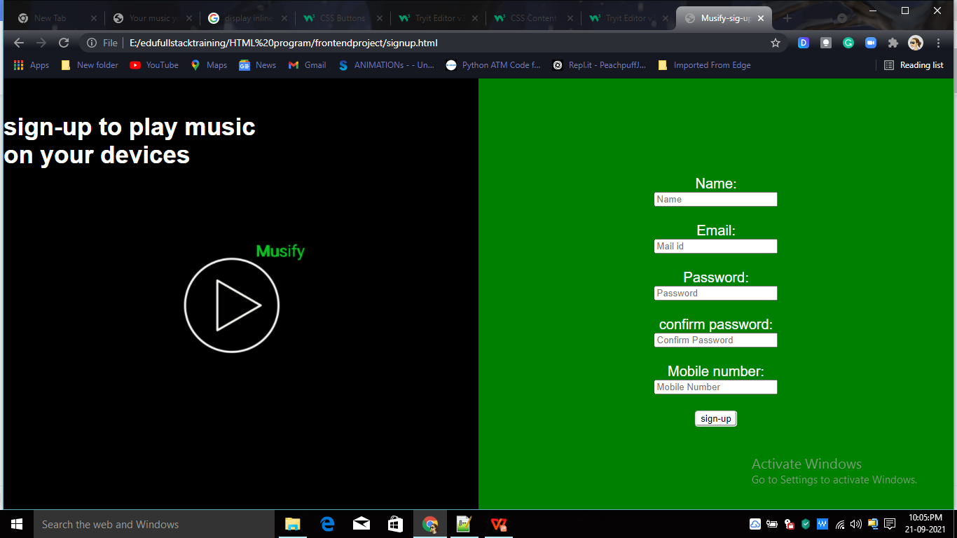
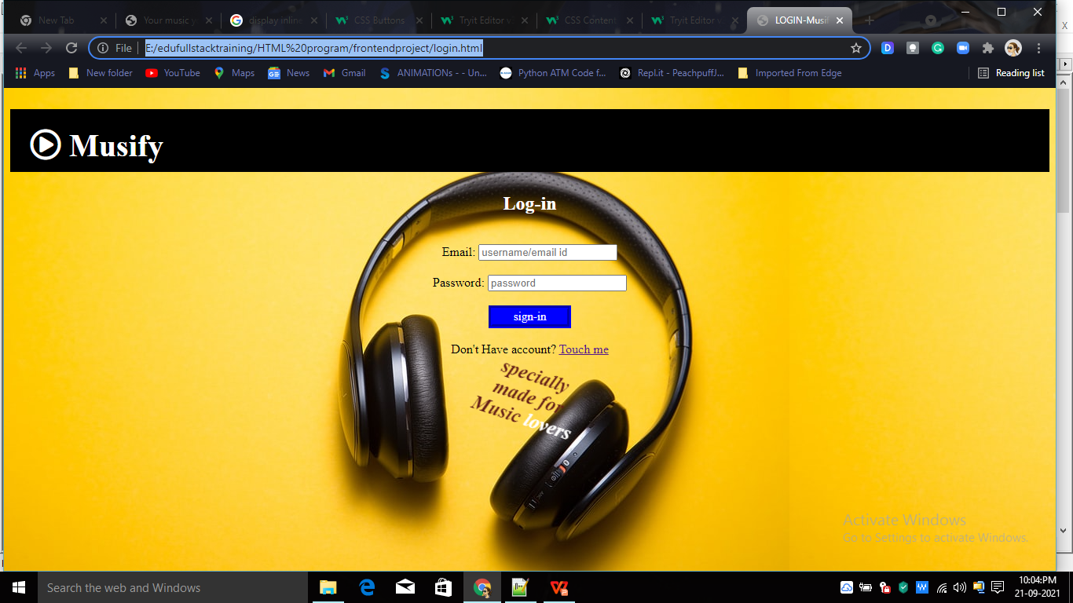
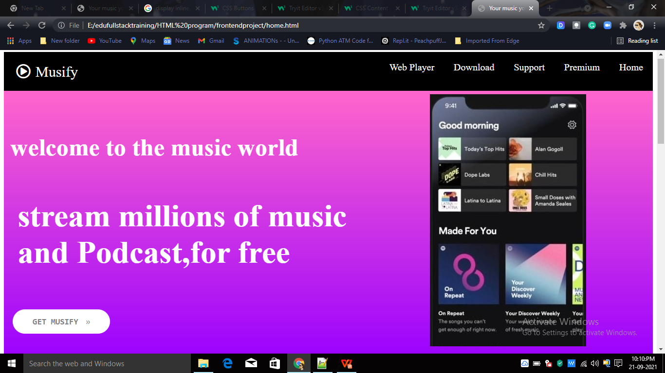
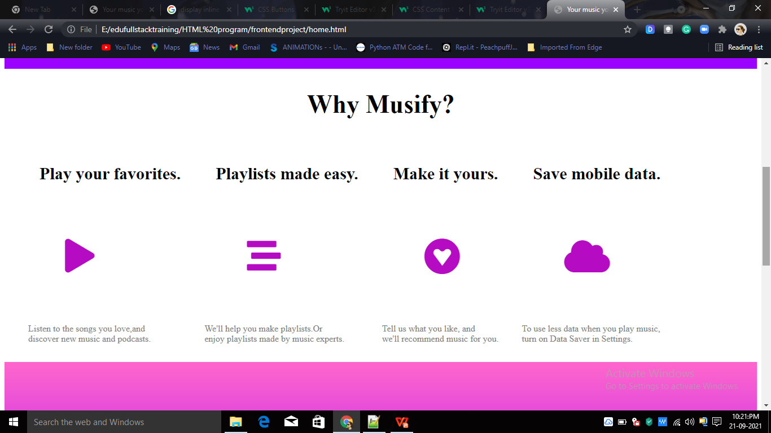
Output
LOGIN PAGE
SIGN UP PAGE
HOME PAGE

Slide 13
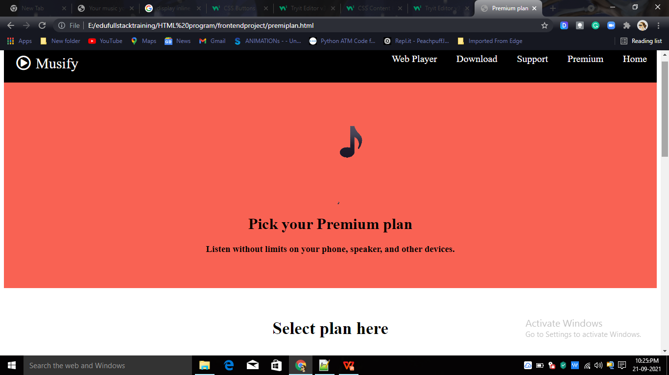
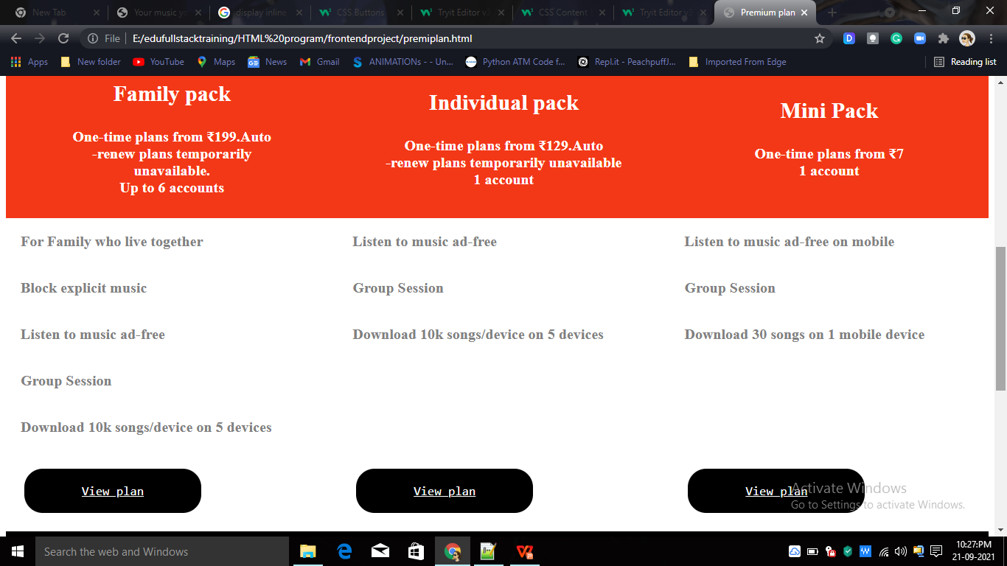
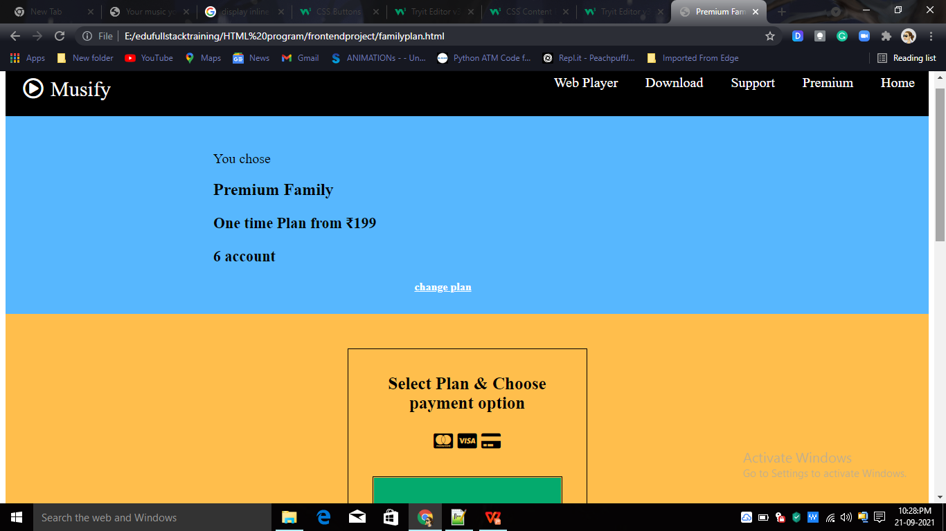
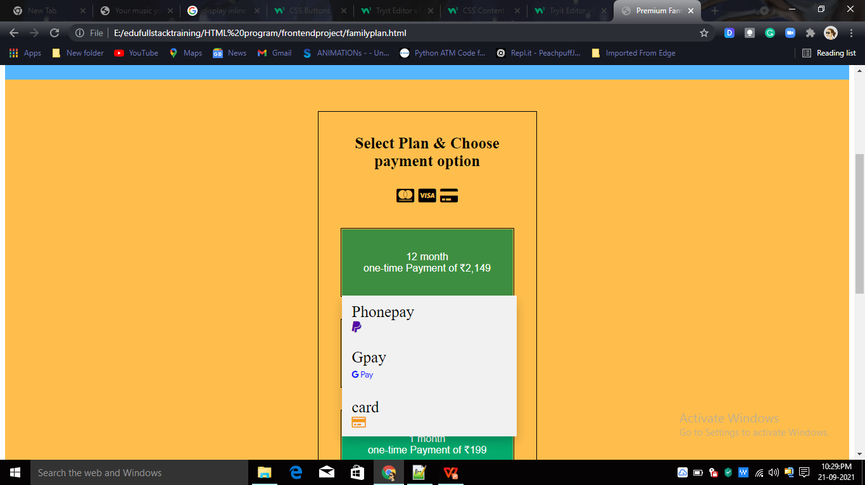
PREMIUM PLAN PAGE

Slide 14
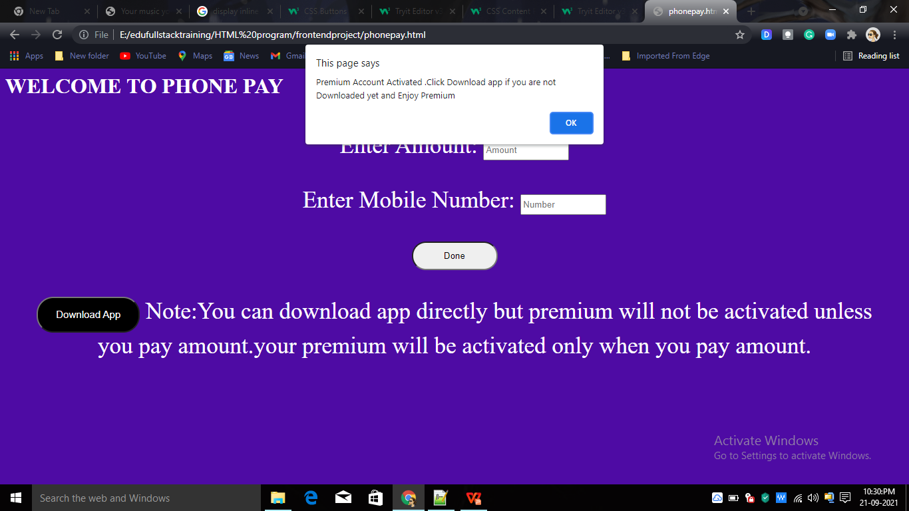
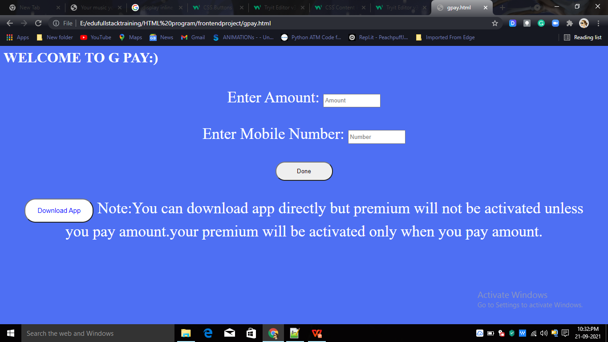
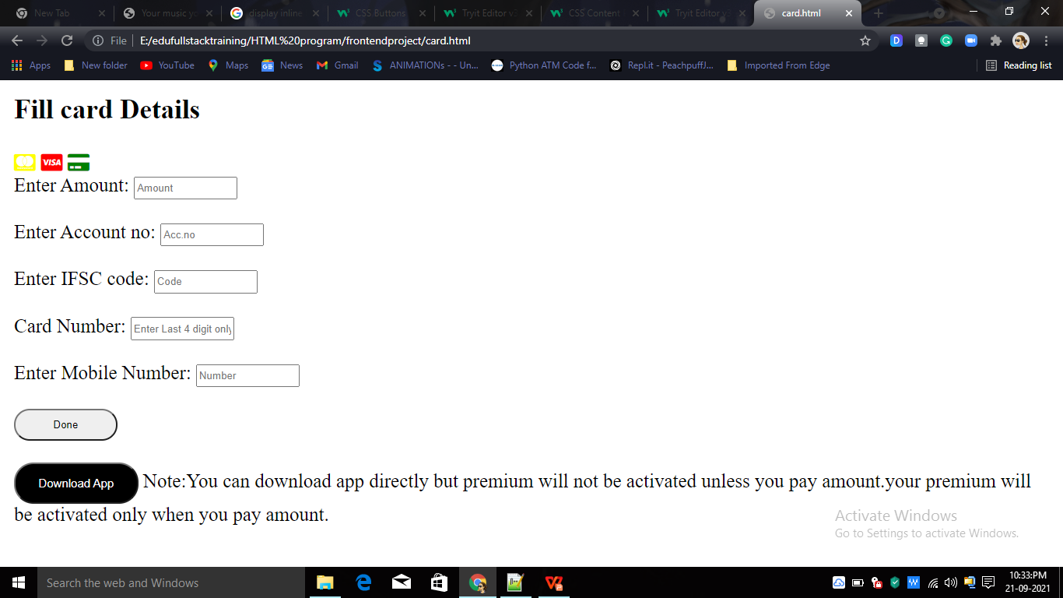
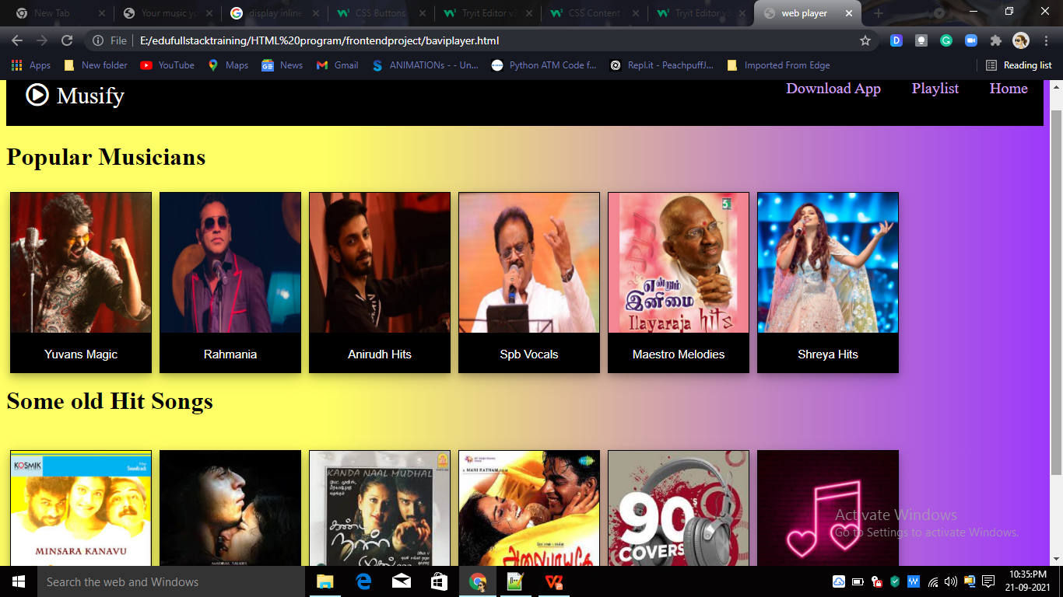
PHONEPAY PAGE
GPAY
CARD
WEB PLAYER PAGE

Slide 15
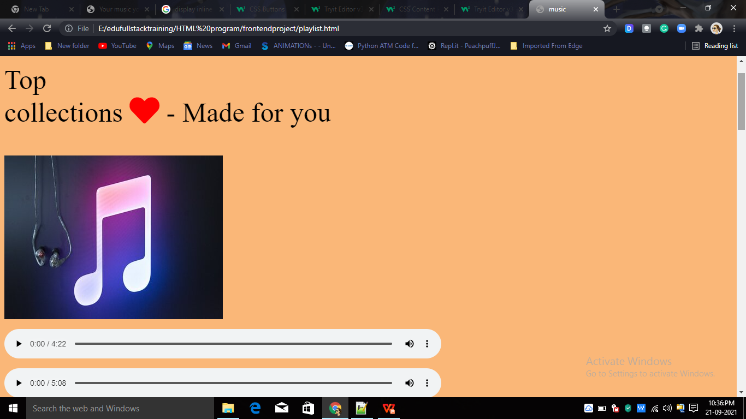
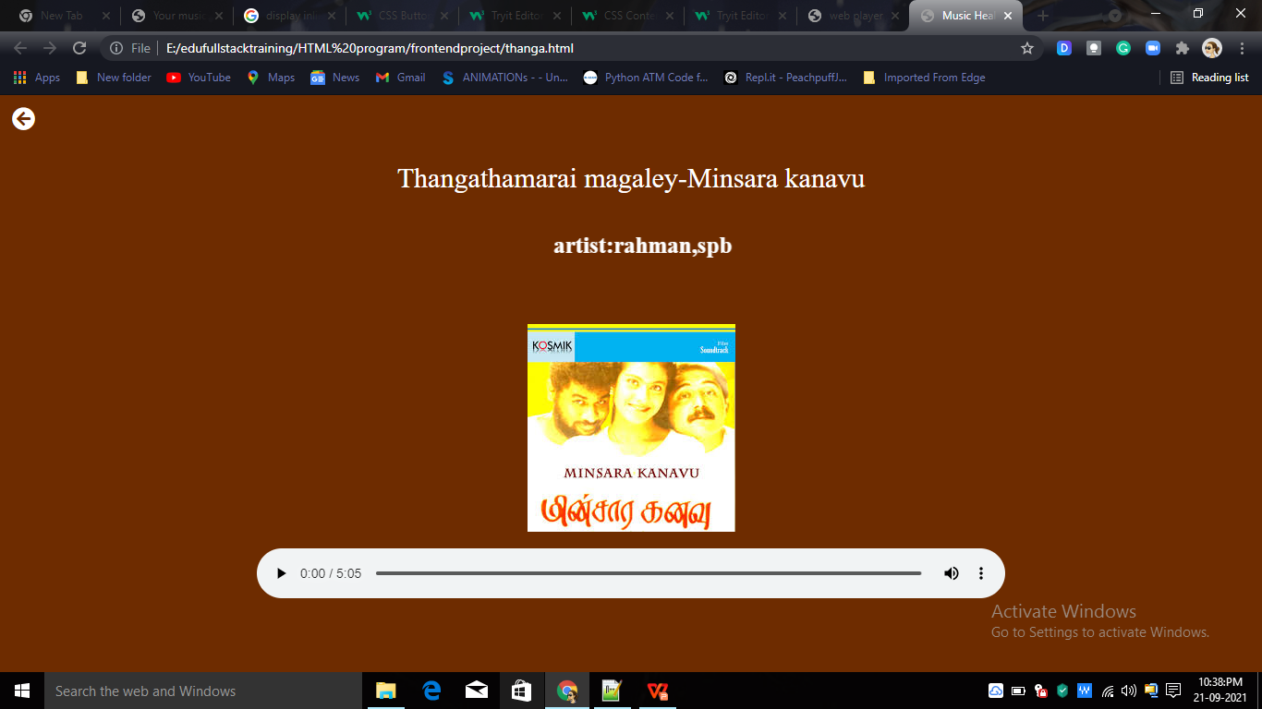
WEB PLAYER PLAYLIST
WEB PLAYER SONG

Slide 16
THANK YOU:)

